Slide 1



ENERGY CONSUMPTION AND PREDICTION
An overview of data preprocessing, visualization, and encoding.
BY
SREEDEVI R.M.

Slide 2
CONTENTS
Objective
Project Overview
Milestone 1
Milestone 3
Milestone 4
Milestone 2
Final insights
Data conclusion

Slide 3
OBJECTIVE OF THE PROJECT:
The central aim of this project is to conduct a comprehensive analysis of energy consumption data to uncover significant patterns and develop a high-accuracy predictive model to assess future energy usage. By leveraging robust data exploration, insightful visualizations, and machine learning techniques, this project aims to derive actionable insights and reliable predictions for optimizing energy efficiency and resource allocation.
3

Slide 4


Project overview
1. Data Preparation
2. Data Visualization
Project overview
3. Data Encoding
4. Machine learning models
5. Time series forecasting

Slide 5

DATA PREPARATION
5

Slide 6
The dataset contain time-series data about household energy consumption, where measurements of power, voltage, and other electrical readings are collected over time. The data covers 377,022 entries (rows) with 9 columns. DATASET FEATURES Date : The date on which the measurements were recorded. Time : The time of day when the measurement was taken. Global_active_power : The total active power consumed across the household. Global_reactive_power : The total reactive power consumed across the household. Voltage : The voltage level in the household, measured in volts (V). Global_intensity : The intensity of current drawn by the appliances in the household. Sub_metering_1 : Energy sub-metering for the first area in the household. Sub_metering_2 : Energy sub-metering for the second area in the household. Sub_metering_2 : Energy sub-metering for the third area in the household.
Dataset Characteristics
6

Slide 7
Analysis | Definition | Observation
df.describe() | Describing the statistical summary of numerical type data | * count : 373,093 non-null entries out of 377,022 total rows. This means there are 3,929 missing values in the Sub_metering_3 column.
df.info() | Displays a concise summary of the DataFrame, including non-null counts and data types. | * The dataset consists of 377,022 rows and 9 columns. * Most columns, including "Date," "Time," "Global_active_power," "Global_reactive_power," "Voltage," "Global_intensity," "Sub_metering_1," and "Sub_metering_2," are stored as strings (object datatype), indicating that they contain textual or numeric data that hasn't been converted to numerical types yet.
7

Slide 8
df.shape | Dimension of the dataframe | The dimension of the dataframe is (2075259, 9)
df.isnull().sum() | Display the count of missing values for each column | The data column Submetering_3 alone has missing values of about 25979
df.dropna() | Data cleaning, it will Drop rows with null values | After dropping null value rows , now the dimensions is 2049280 rows × 9 columns
df.fillna(0) | Will fill 0 in place of null values | It shows no null values ,if we run df.isnull() after fillinf zeros in place of null values

Slide 9
DATA VISUALIZATION
9

Slide 10
Data visualization is essential for analyzing and interpreting datasets effectively. Line plots are widely used to track trends over time, providing a clear view of variations. Box plots help in summarizing data distribution, identifying outliers, and understanding data spread. Pair plots visualize relationships between multiple variables, offering insights into correlations. Histograms are ideal for analyzing the frequency distribution of numerical data. Scatter plots show the relationship between two variables, highlighting patterns or clusters. Lastly, bar plots are effective for comparing categorical data, showcasing differences across groups or categories visually..
10

Slide 11
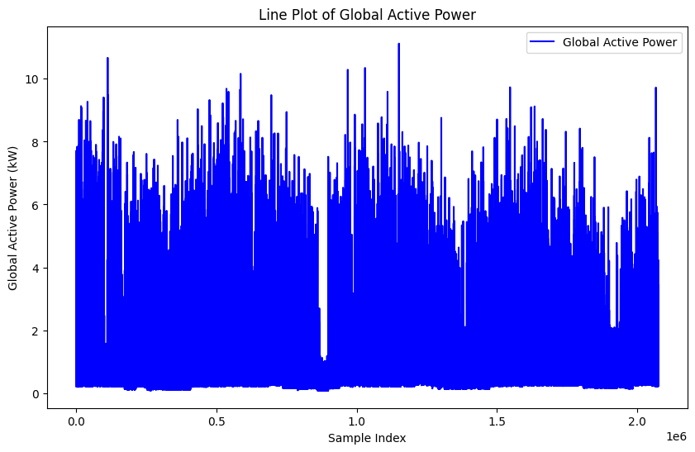
The line plot shows that Global Active Power fluctuates widely, with values generally between 0 and 8 kW, but with periodic spikes exceeding 10 kW. There appear to be cyclic patterns, suggesting recurring periods of higher and lower power usage, possibly aligned with daily or weekly routines.
LINE PLOT
11

Slide 12
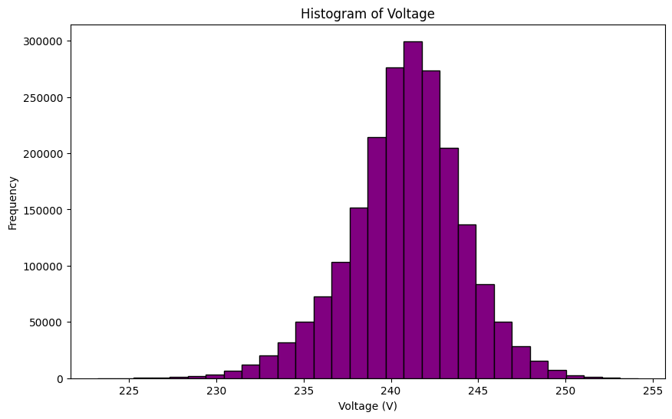
*This histogram of Voltage shows a nearly symmetrical, bell-shaped distribution centered around 240 volts. *Most voltage values are concentrated between 235V and 245V, with the highest frequency around 240V, indicating that this is the typical operating voltage. * The distribution tapers off on both ends, with very few instances of voltage below 230V or above 250V. This suggests that voltage remains relatively stable around 240V, with only minor deviations. *The shape of the distribution indicates a normal, consistent supply of voltage.
HISTOGRAM
12

Slide 13
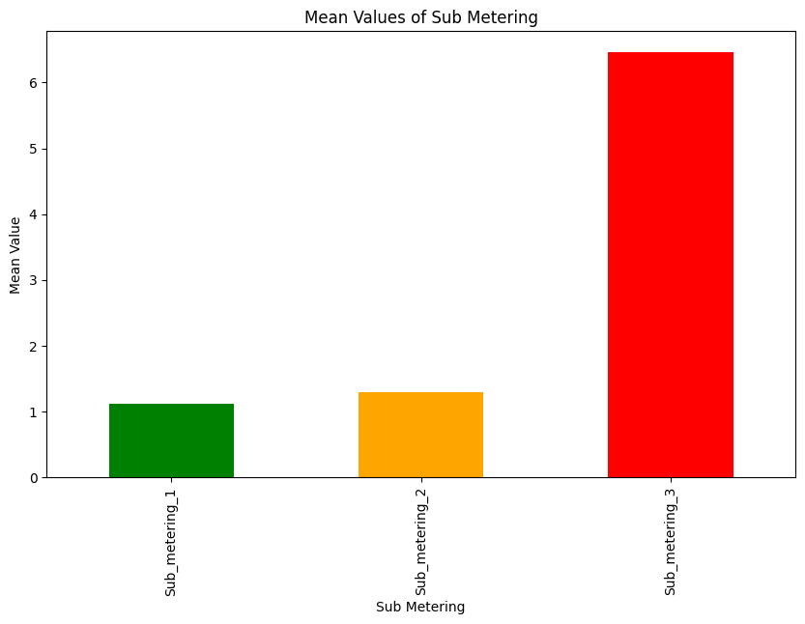
This bar plot shows the mean values of Sub Metering across three categories. Sub_metering_3 has the highest average consumption, significantly exceeding that of Sub_metering_1 and Sub_metering_2. This suggests that the devices or areas represented by Sub_metering_3 consistently consume more energy than the other two sub-metered areas. Both Sub_metering_1 and Sub_metering_2 have relatively similar mean values, which are much lower than that of Sub_metering_3. This indicates a likely difference in the type or intensity of power usage between these sub-metered areas.
BAR PLOT
13

Slide 14
DATA ENCODING
14

Slide 15
Data encoding is the process of converting categorical data into numerical formats so that machine learning algorithms can interpret it.
DATE
TIME
DATA ENCODING
YEAR
MONTH
DAY
HOURS
MINUTES

Slide 16
MACHINE LEARNING MODELS
16

Slide 17
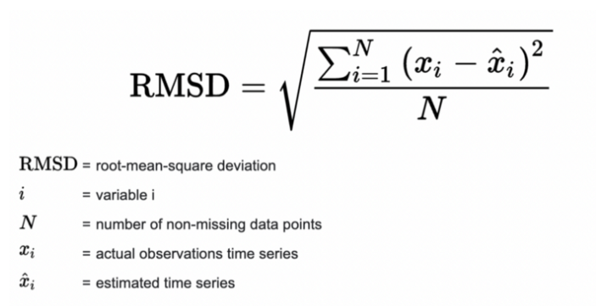
MACHINE LEARNING MODELS
Linear Regression
Lasso Regression
Ridge Regression
Logistic Regression
17

Slide 18
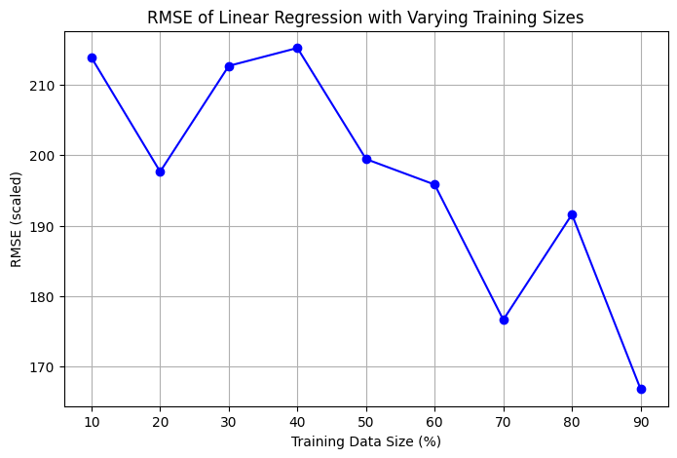
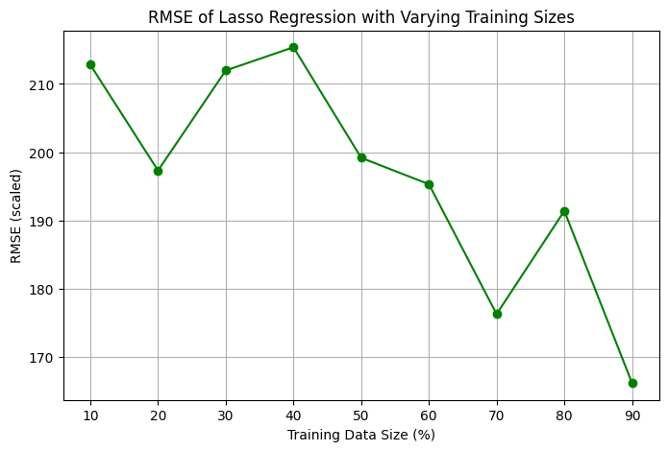
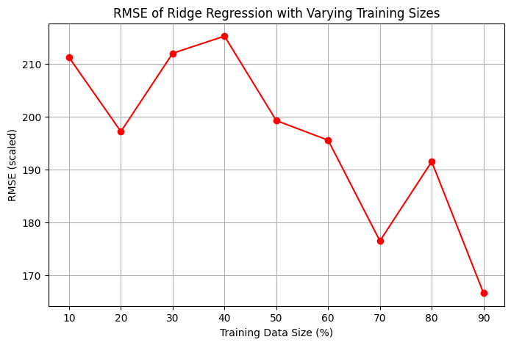
18

Slide 19
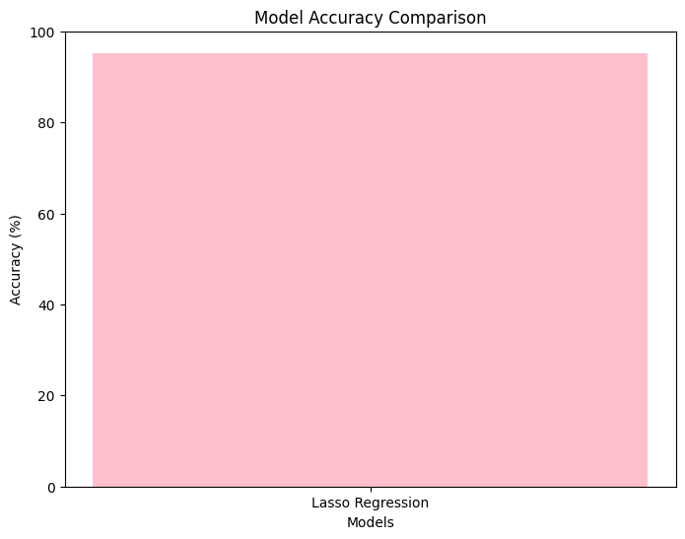
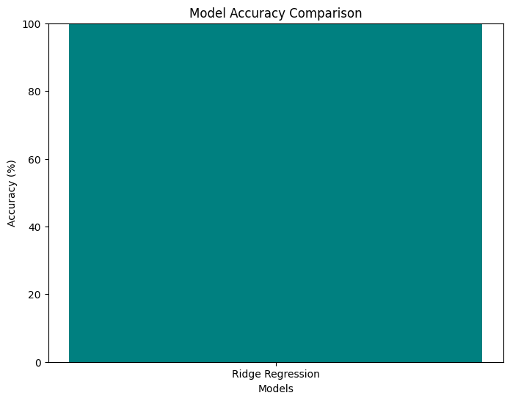
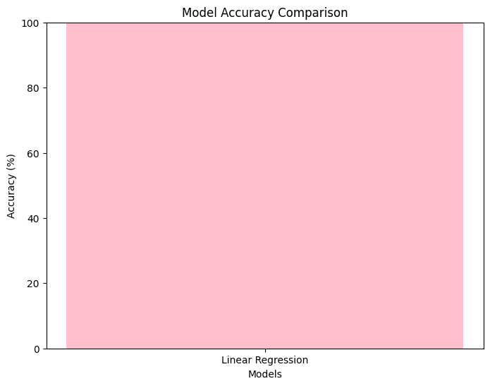
Accuracies for ML Models
19

Slide 20
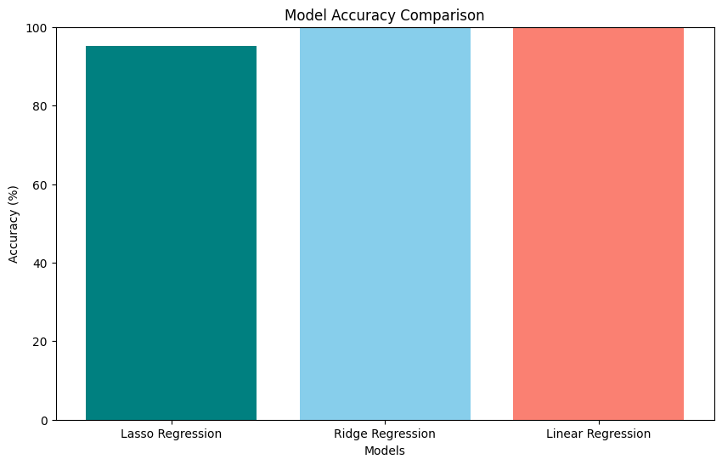
20

Slide 21
TIME SERIES FORECASTING
21

Slide 22
COMBINED OBSERVATIONS FOR PROPHET FORECASTS
The forecasts accurately capture the overall trends in energy consumption, providing reliable predictions for both short-term and long-term periods.
The 7-day forecast is more precise, while the 30-day forecast smooths fluctuations but loses some accuracy in capturing short-term spikes.
High variability and sharp spikes in energy consumption are not fully captured by the model, highlighting its limitation in handling extreme outliers.
The uncertainty intervals widen over time, indicating increased prediction uncertainty for longer forecast horizons.
Prophet effectively models general trends and seasonality but may require further tuning to handle irregular patterns and high-frequency spikes.
22

Slide 23
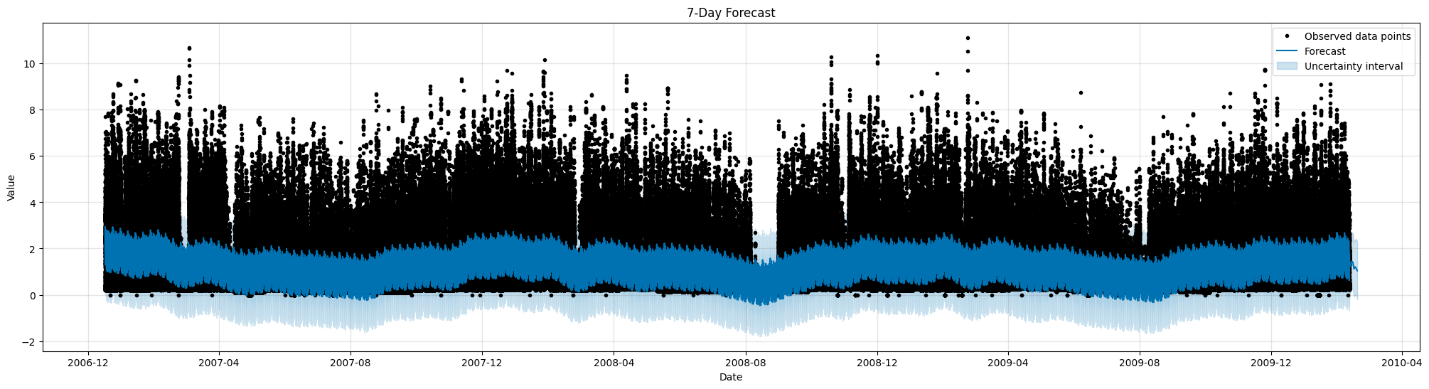
23

Slide 24
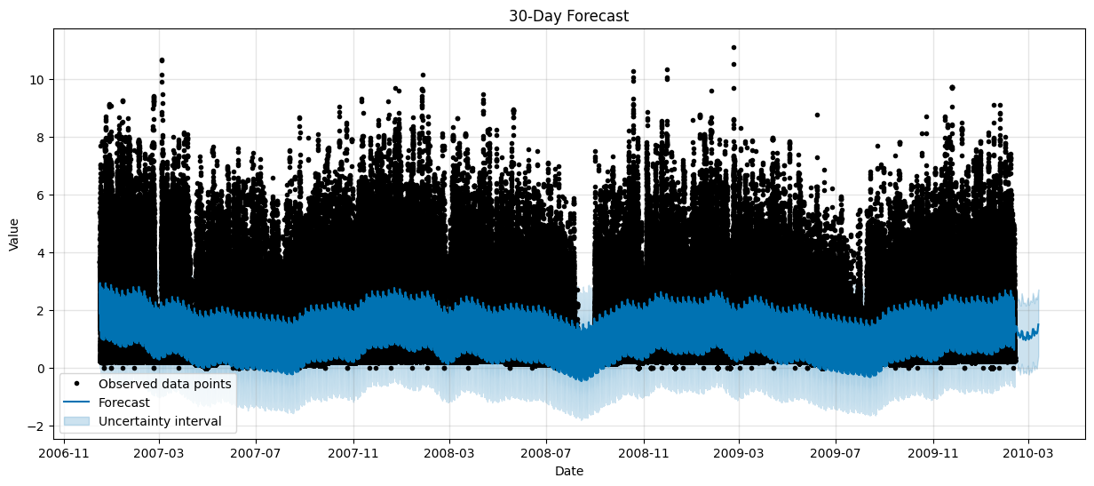

Slide 25

FINAL INSIGHTS
Class Imbalance:
The energy consumption dataset may have periods with very low or high consumption, causing an imbalance in data distribution (e.g., 90% low consumption, 10% high consumption). This imbalance could lead to models being biased toward predicting the more frequent consumption patterns.
Impact on Performance:
While the model may show high accuracy, it could fail to predict high consumption periods or energy peaks effectively, as it is more likely to predict the dominant low consumption periods.
25

Slide 26
FINAL INSIGHTS
Evaluation Metrics:
Metrics like mean absolute error (MAE), root mean squared error (RMSE), and R-squared provide a better understanding of model performance, especially when predicting fluctuating energy consumption patterns.
Analysis Conducted:
In this project, data preprocessing (like resampling, normalization), visualizations (such as line plots for trends, and box plots for consumption distribution), and modeling (using techniques like ARIMA, Prophet, or machine learning models) play a significant role in improving predictions and addressing consumption variations.
26

Slide 27




Thank you

